Slide 1
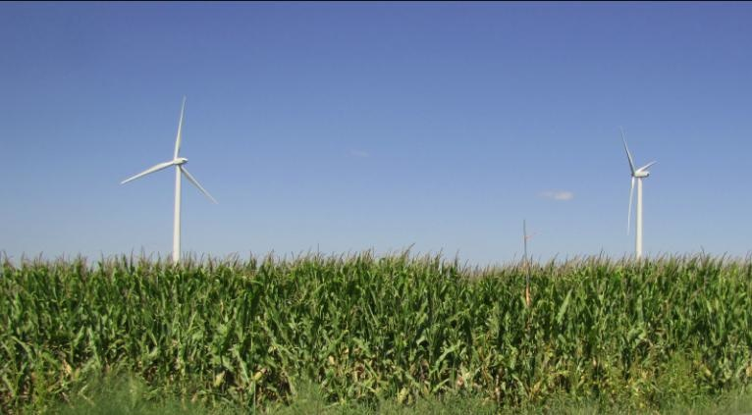
The Central Iowa Wind Energy Field Measurement Site:
Recent Results and a Vision for the Future
Eugene S. Takle
Department of Agronomy
Department of Geological and Atmospheric Science
Director, Climate Science Program
Iowa State University
Collaborators: J H Prueger, D A Rajewski, J K Lundquist, J Hatfield, R Doorenbos
Clyde Kohn Colloquium
Department of Geography
The University of Iowa
Iowa City, IA
11 November 2011

Slide 2
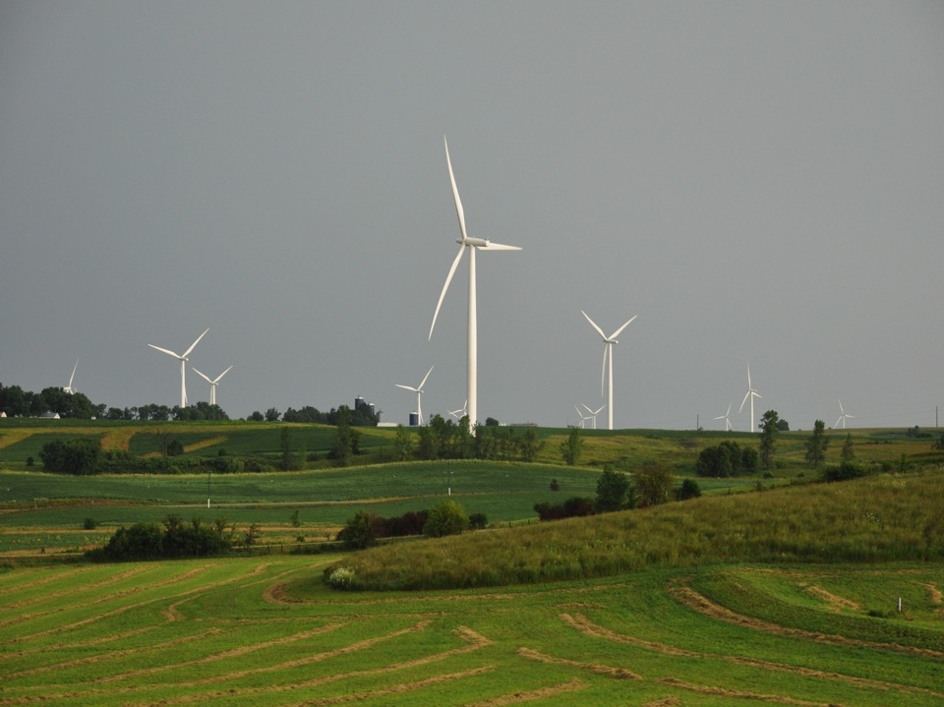
Outline:
History and Motivation
Conceptual Model
Field Experiment
Preliminary Results
Low-Level Jet
Wind Shear
2011 Field Campaign
Photo courtesy of Lisa H Brasche

Slide 3
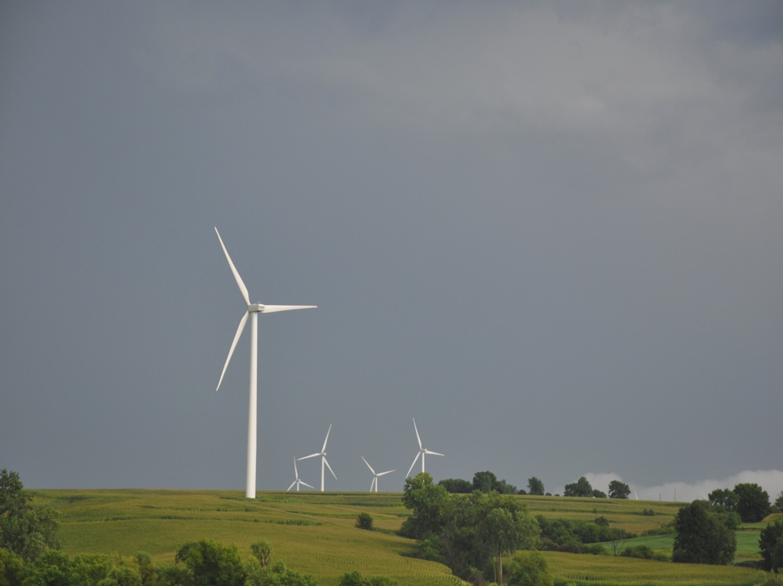
Crop/Wind-energy Experiment
(CWEX)
Began 2009-2010 as a seed grant funded by the
Center for Global and Regional Environmental Research
Attracted funding from the
Ames Laboratory, DOE
Attracted participation by the
National Laboratory for Agriculture
and the Environment
Photo courtesy of Lisa H Brasche

Slide 4
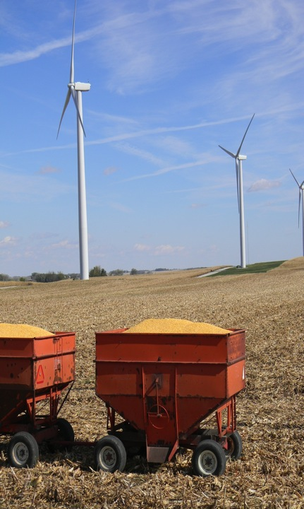
CWEX Motivation:
Two Components
Public acceptance of wind turbines
  Multi-use, high-land-value environment
  Crops are tuned to climate conditions
  Do changes in temperature, humidity, wind speed, turbulence, and CO₂ due to wind turbines influence crop growth and yield?
Testbed for validating high-resolution models of wind-farm performance and coupling to surface and PBL
  General understanding of impacts of turbines
  Understand turbine-turbine interaction and wind-farm performance
  Options for further wind farm build-out: Go higher? More dense?
  Iowa has a flat terrain, strong LLJ, not unlike coastal jets, many existing windfarms and component manufacturers: good zero-order testbed for off-shore technologies

Slide 5
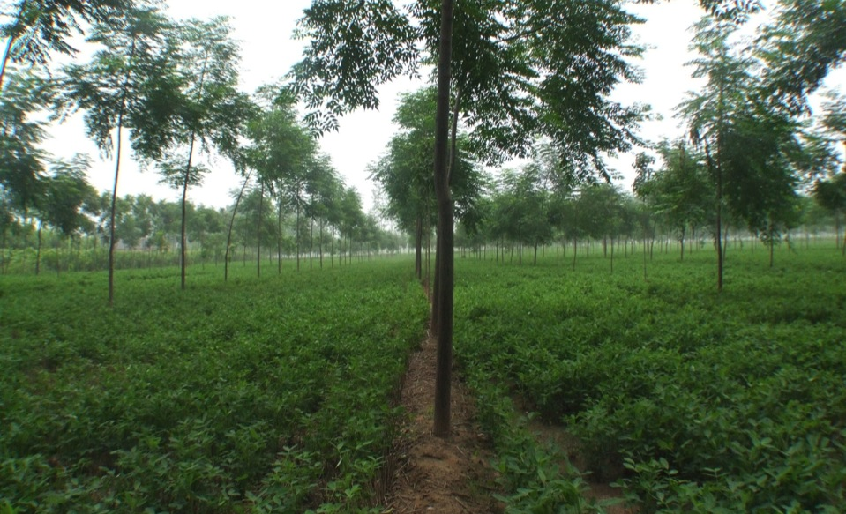
Some Inspiration from China

Slide 6
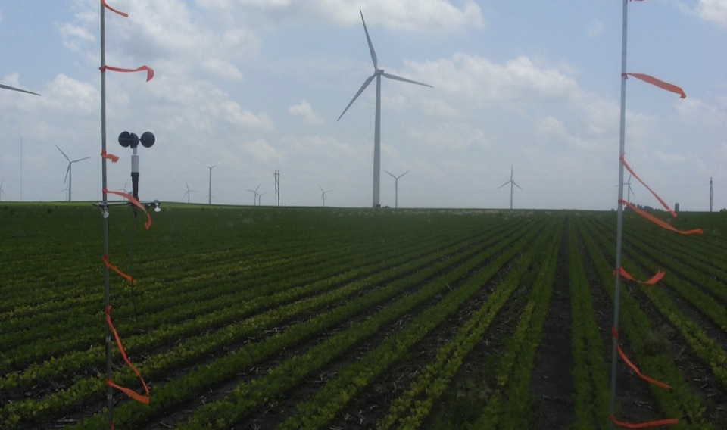
What Turbine Density Optimizes Wind Power Production and Agricultural Production?

Slide 7
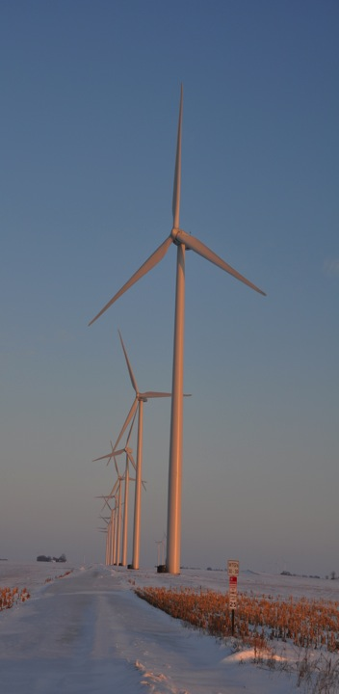
Turbine-Crop Interactions:
Overview
Do turbines create a measureable influence on the microclimate over crops?
If so, is this influence create measureable biophysical changes?
And if this is so, does this influence affect yield?
Agricultural shelterbelts have a positive effect on crop growth and yield.
Will wind turbines also have a positive effect?
Photo courtesy of Lisa H Brasche

Slide 8
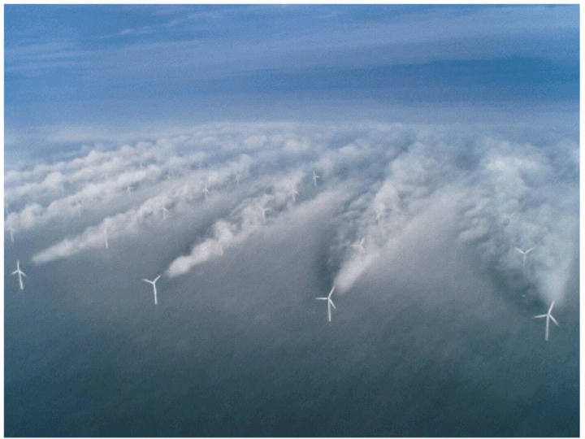
Source: UniFly A/S
Horns Rev 1 owned by Vattenfall. Photographer Christian Steiness.

Slide 9
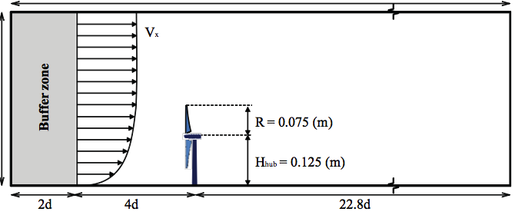
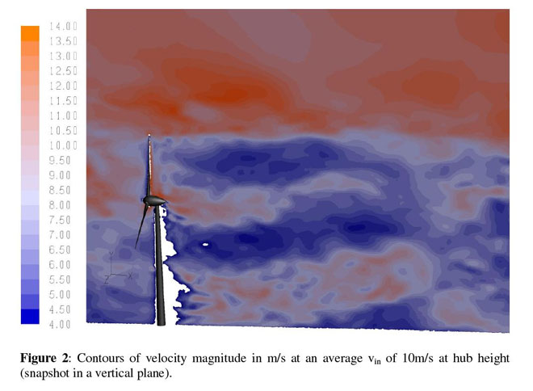
Porté-Agel, Lu, and Wu, 2010
Wuβow, Sitzki, & Hahn, 2007, CFD simulation using ANSYS FLUENT 6.3 LES

Slide 10
Conceptual Model of Turbine-crop Interaction via Mean Wind and Turbulence Fields
Speed recovery
day
H₂O
CO₂
Heat
__ ___________________________________
night

Slide 11
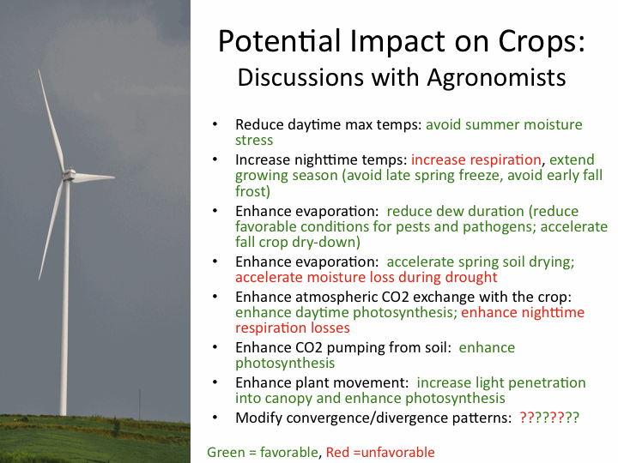
Photo courtesy of Lisa H Brasche

Slide 12
CWEX10 Field Experiment
Central Iowa wind farm ( 200 1.5-MW turbines)
Southern edge of a wind farm
Corn-soybean cropping pattern (measurements made in corn)
26 June – 7 September 2010; turbines off 0700 LST 26 July – 2300 LST 5 Aug 2300
4 Eddy Covariance flux towers
NREL/CU Lidar (J. Lundquist) (28 June-9 July)

Slide 13
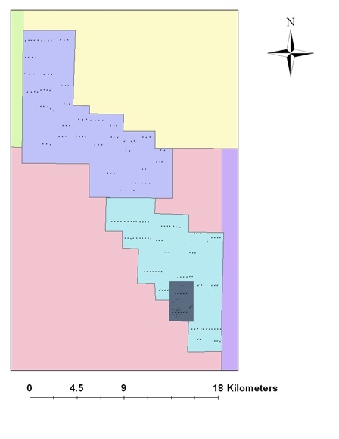
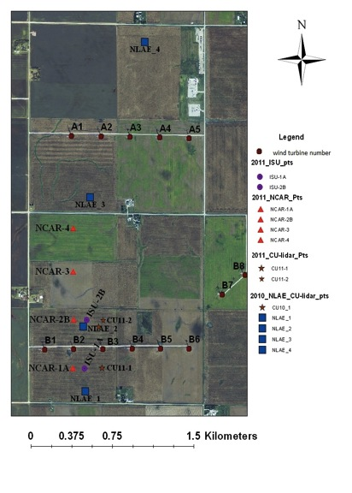
CWEX10/11 Instrument Deployment
Story II
Story I

Slide 14
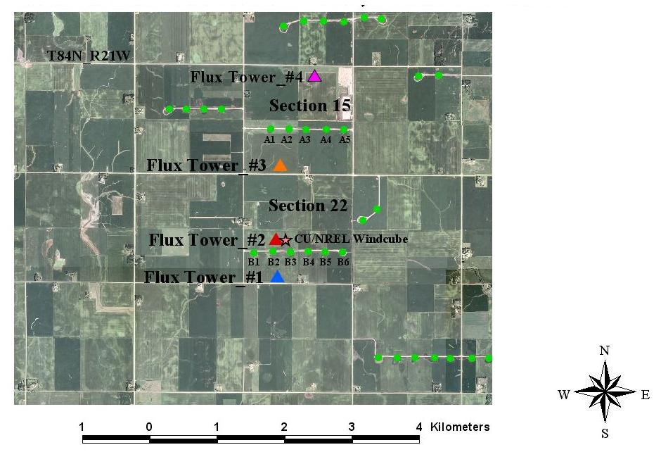
4 flux towers
  maize canopy
  26 June – 7 Sept, 2010
CU/NREL Lidar
  28 June - 9 July 2010

Slide 15
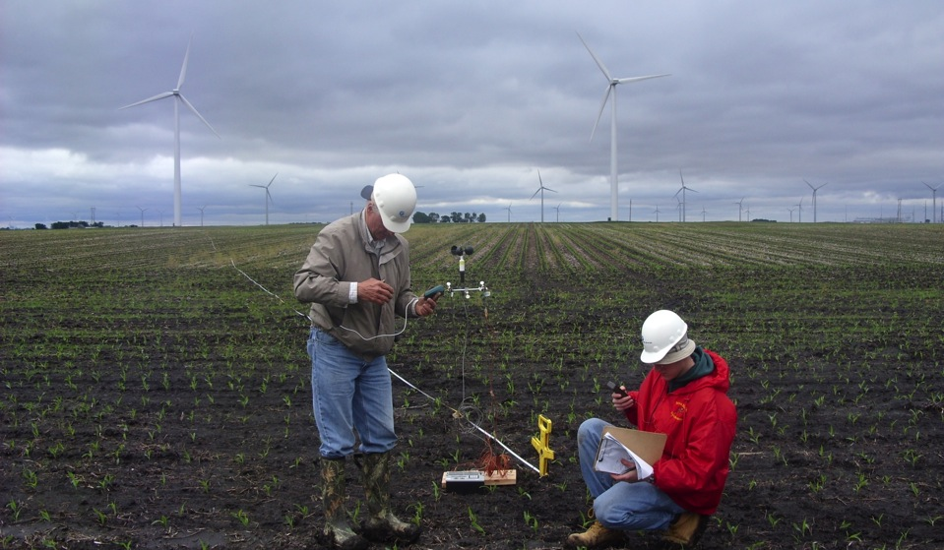
Preliminary Observations

Slide 16

Low-Budget Beginnings

Slide 17
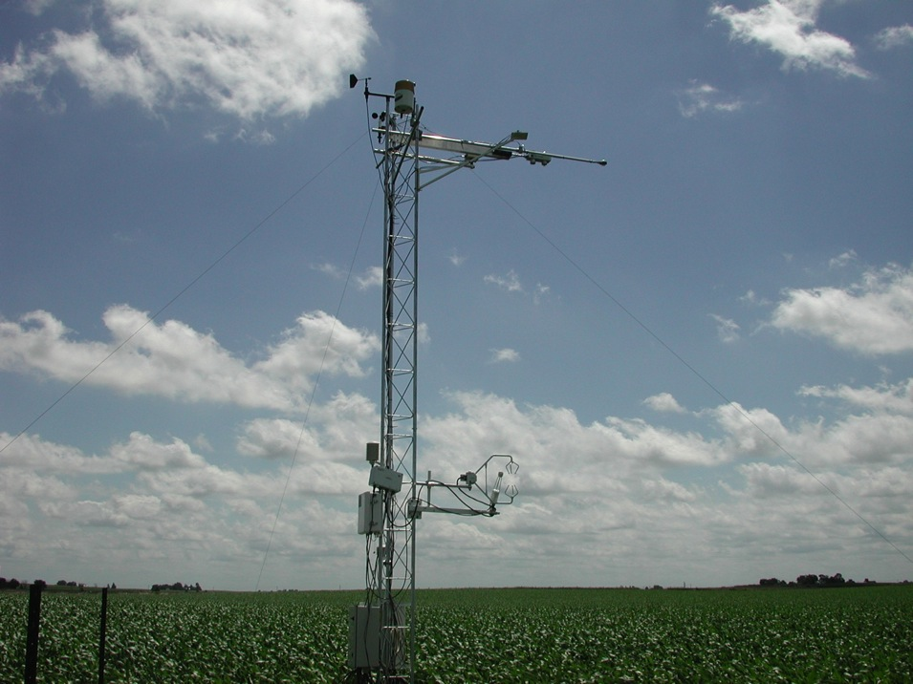

Slide 18
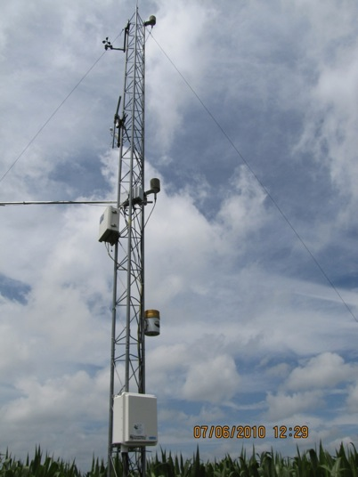
Flux Tower Instrumentation
Each tower
--cup anemometer at 9.1 m
-- T & RH at 9.1 m and 5.3 m
--sonic anemometer at 6.45 m
---tipping bucket at 3.75 m
Two towers (reference and near-wake location)
--Net radiometer
--Open path CO2/H20 IRGA LI-7500
Sonic anemometer and Li-7500 sampled at 20 Hz w/ 5 min averages
T, RH, cup anemometer, rain gage output archived at 5 min

Slide 19
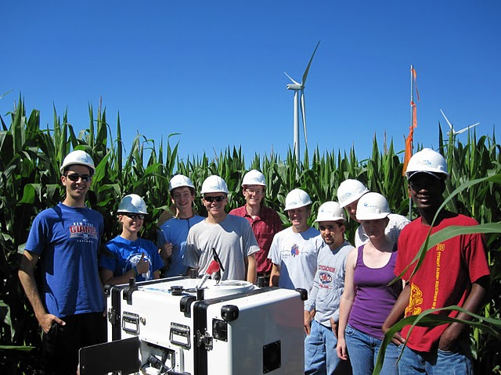

Slide 20
CWEX10 Data analysis
Focus on ‘differences’ in crop microclimate at flux tower locations
Pay attention to wind direction
Turbines on – turbines off
Isolate instrument and location biases
  Reference sonic temperature ~ 0.6-0.8ºC high
  possible influence from localized advection (large pond and wet field 1 km SE of the reference tower)

Slide 21
Wind speed comparison at 9 m
Preliminary
South wind: Turbines On
NW wind: Turbines On
South wind: Turbines Off
NW wind: Turbines Off

Slide 22
Wind speed comparison at 9 m
Preliminary
South wind: Turbines On
NW wind: Turbines On
Daytime wind speed decrease
South wind: Turbines Off
NW wind: Turbines Off

Slide 23
Normalized TKE comparison at 6 m
Preliminary
South wind: Turbines On
NW wind: Turbines On
More turbulence at night
South wind: Turbines Off
NW wind: Turbines Off

Slide 24
u’w’ comparison at 6 m
Preliminary
South wind: Turbines On
NW wind: Turbines On
Higher nighttime surface stress
South wind: Turbines Off
NW wind: Turbines Off

Slide 25
Air temperature comparison at 9 m
Preliminary
South wind: Turbines On
NW wind: Turbines On
Cooler during day, warmer at night
?
South wind: Turbines Off
NW wind: Turbines Off

Slide 26
Carbon flux w’CO₂’ around peak LAI
Preliminary
NW W NW W SW
W SW W SW S SE
Higher carbon uptake by crop behind turbines
Higher nighttime respiration behind turbines
9 Jul
10 Jul
10 Jul
11 Jul

Slide 27
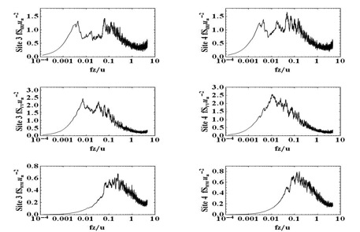
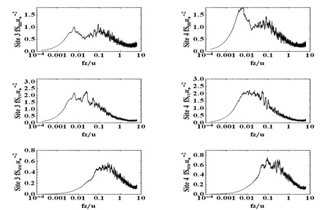
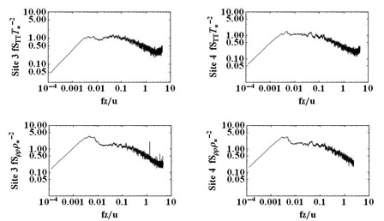
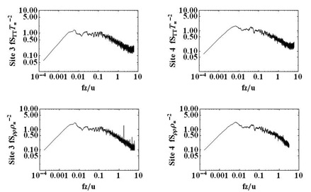
CWEX10 Spectral Plots: 27 July 27 1200-1300
Tubines On
Tubines Off
u’²
Upwind
Downwind
u’²
Upwind
Downwind
v’²
Upwind
Downwind
v’²
Upwind
Downwind
w’²
Upwind
Downwind
w’²
Upwind
Downwind
T’²
Upwind
Downwind
T’²
Upwind
Downwind
P’²
Upwind
Downwind
P’²
Upwind
Downwind

Slide 28
Summary
Preliminary analysis seemed to show a measureable influence of turbines on microclimate over crops.
However
More in-depth analysis (wavelets, spectral analysis), more days of observation, different overall wind conditions shows more inconsistencies
Not sure that preliminary measurements represent general conditions

Slide 29
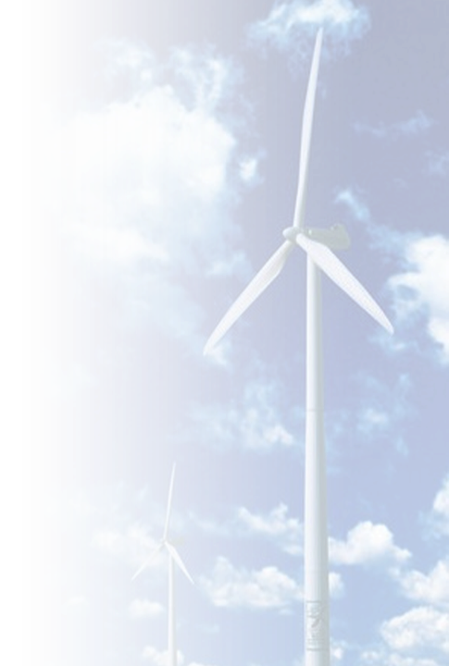
The dynamics of the lower atmosphere are complex, especially at night
Radiosonde profiles demonstrate that the cooling of the surface overnight is accompanied by dramatic accelerations in the winds
1800 LST
2200 LST
0200 LST
0800 LST
1800 LST
2200 LST
0200 LST
0800 LST
Height above surface [m]
Height above surface [m]
Wind Speed [ms⁻¹]
Potential Temperature [K]
Poulos, Blumen,
Fritts, Lundquist, et al.,
2002
Julie.Lundquist@nrel.gov
Notes:
As the atmosphere stabilizes over a cold surface, winds accelerate into a jet structure with significant shear on the underside, generating turbulence

Slide 30
Models Don’t Capture Height of Jet Max
Data courtesy of K. Carter and Adam Deppe, ISU
Observations
Models

Slide 31
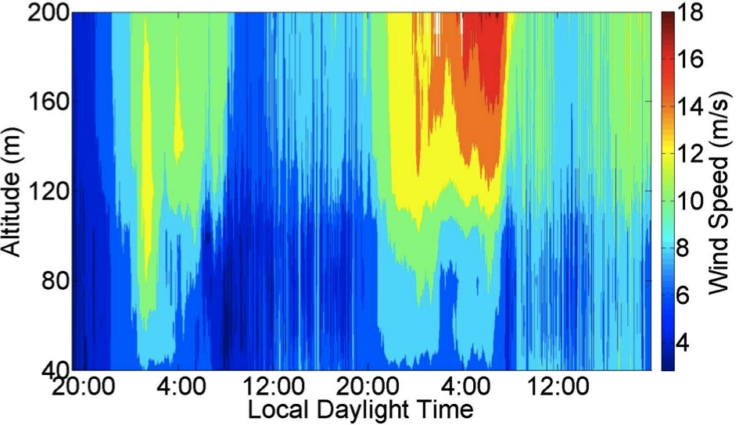
Observed wind speed profiles (Windcube lidar, summer, Midwest US) exhibit more variability than is traditionally considered in CFD
LLJ Max
~ 16 m/s
And these are “typical” midwestern conditions!
LLJ Max
~ 12 m/s
Turbine Wake
Rhodes, Aitken, Lundquist, 2010, 2011
Julie.Lundquist@colorado.edu

Slide 32
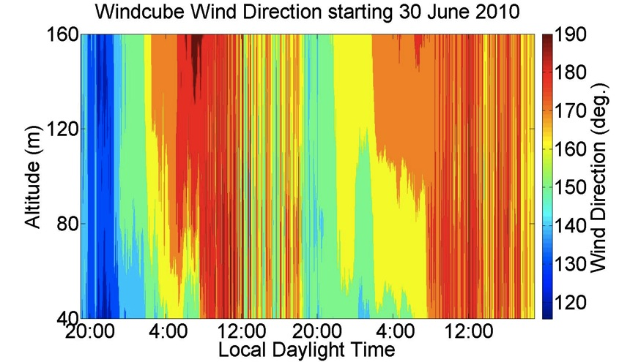
Directional Shear of 20º Across the Rotor Disk is Common
Considerable nocturnal directional shear
And these are “typical” Midwestern Conditions!
Rhodes, Aitken, Lundquist, 2010, 2011, Julie.Lundquist@colorado.edu

Slide 33
CWEX11 Field Campaign
Same location
Measure from June-August
Six measurement stations (instead of 4); four provided by National Center for Atmospheric Research
Two lidars (one upwind, one downwind of turbine line) provided by J. Lundquist, CU
Wind Energy Science, Engineering and Policy Research Experience for Undergraduates (REU) students involved

Slide 34
CWEX10/11 Instrument Deployment
Story II
Story I

Slide 35
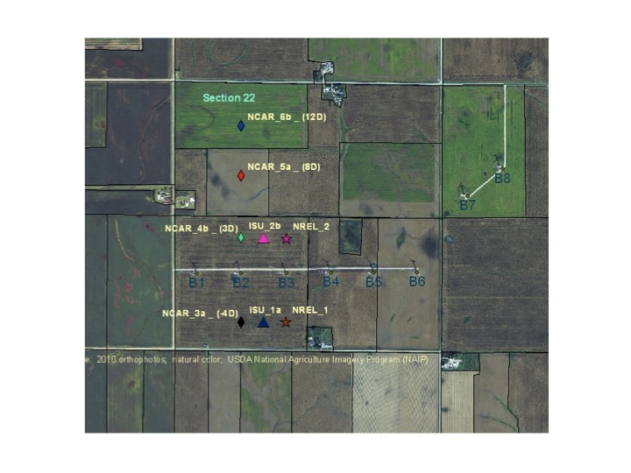
Flux and Lidar Locations for CWEX11

Slide 36
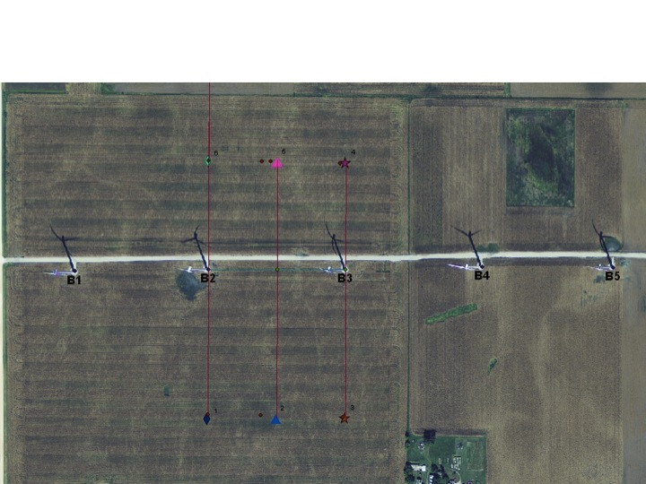
Detail Around Turbine Line B

Slide 37
Data Analysis:
5-min averages, differences between downwind and upwind
Carefully selected wind direction where turbine wake is likely
Omitted periods of data with any error flags for the sonic anemometer at any flux station
Create scatter plots of upwind (NCAR1) z/L₀ vs. difference field (e.g. w[NCAR2-NCAR1])
South case has about 2100 observations
North case has about 900 observations

Slide 38
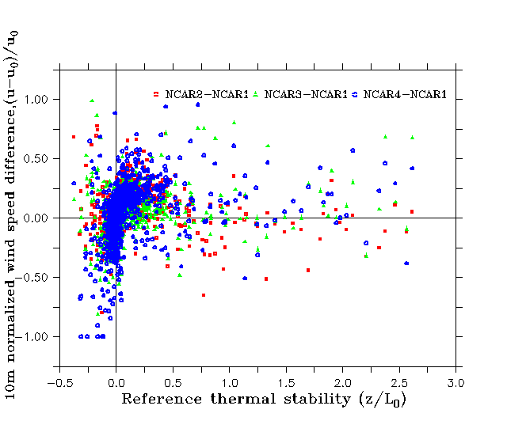
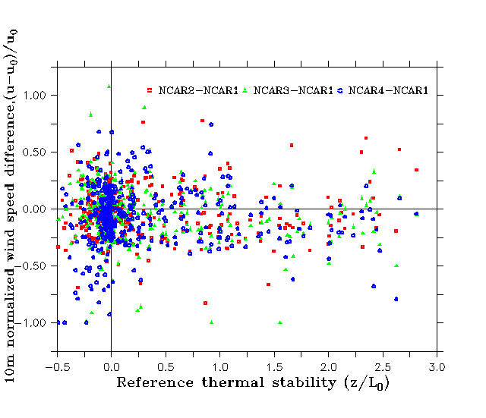
Normalized wind speed difference
South (173°-187°)
North (341°-18°)
Near neutral to slightly
stable conditions favor
larger over speeding
Considerable
scatter in day vs. night with
north winds

Slide 39
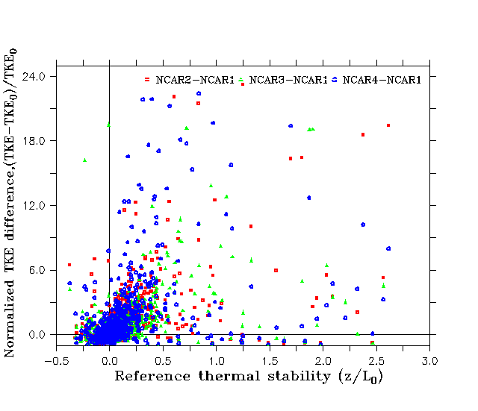
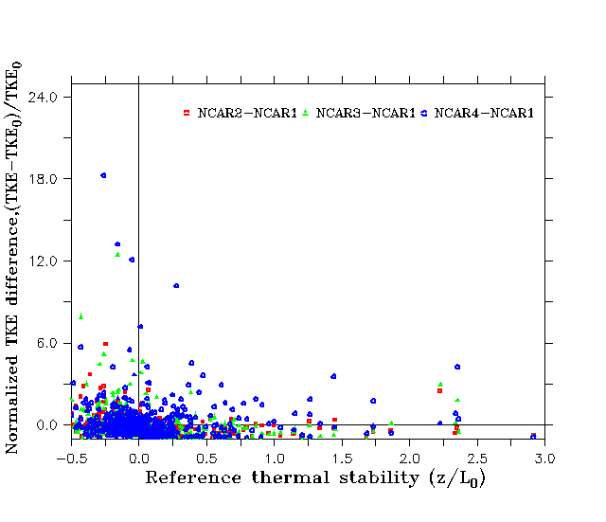
Normalized Turbulence Kinetic Energy Difference
South (173°-187°)
North (341°-18°)
Near neutral to slightly
stable conditions favor enhanced turbulence at the down-wind flux towers
Similar TKE ahead of and behind
wind turbine line, less scatter in strongly
stable conditions

Slide 40
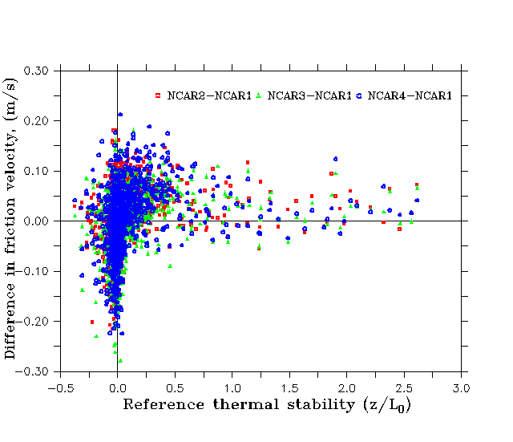
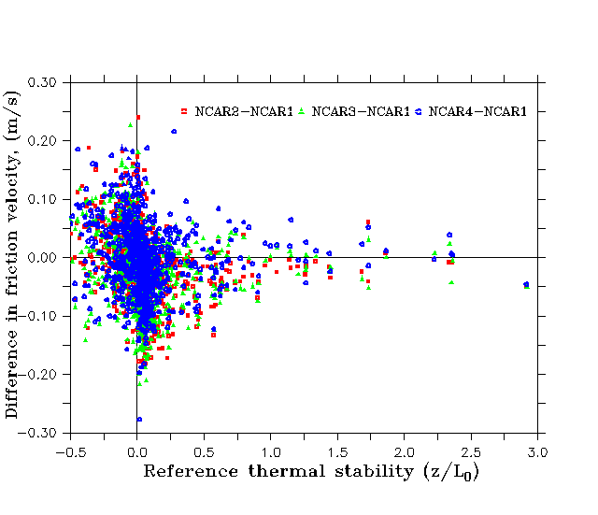
Difference in Friction Velocity (u*)
South (173°-187°)
North (341°-18°)
Similar to wind speed, increase in night-time shear stress downwind of the turbine line
More daytime scatter of u* differences
(turbulence from several lines of turbines upwind)

Slide 41
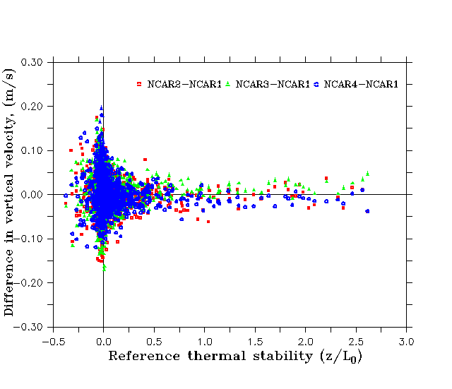
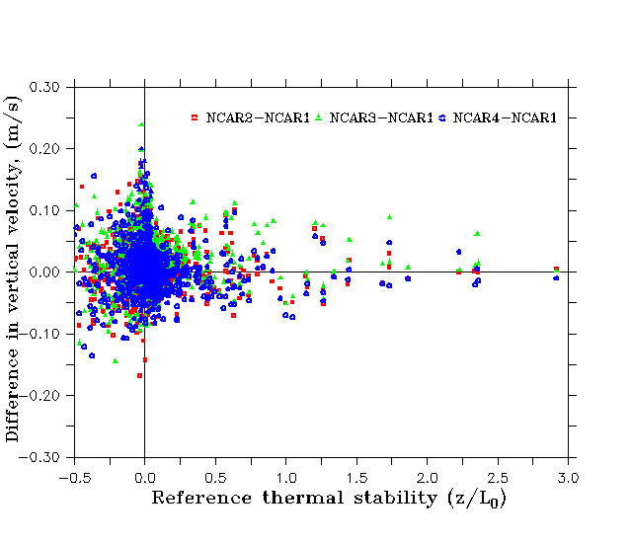
Difference in Mean Vertical Velocity
South (173°-187°)
North (341°-18°)
Stable stratification suppresses vertical motion downstream of the turbines
Enhanced turbulence from several lines of turbines counteracts stability
quenching effect of vertical velocity

Slide 42
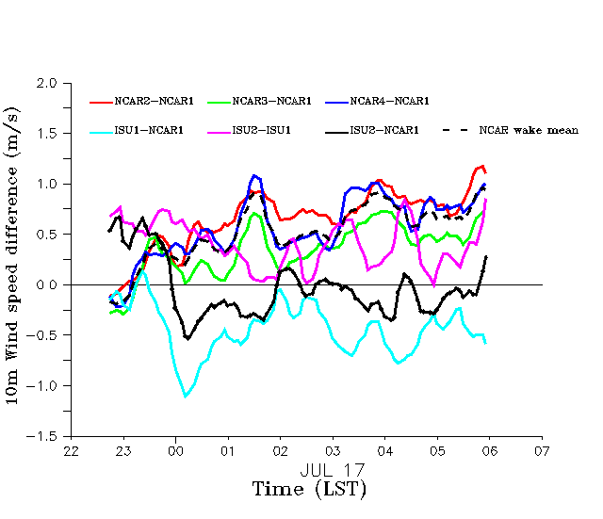
CASE STUDY:
Night 16 Jul 2230-17 Jul 0600
NCAR towers all show over speeding (NCAR2 closest to the rotor)
Speedup is greatest
farther downstream
ISU2 least amount of speed increase
Note : ISU wind speed at 8 m vs. 10m for NCAR towers

Slide 43
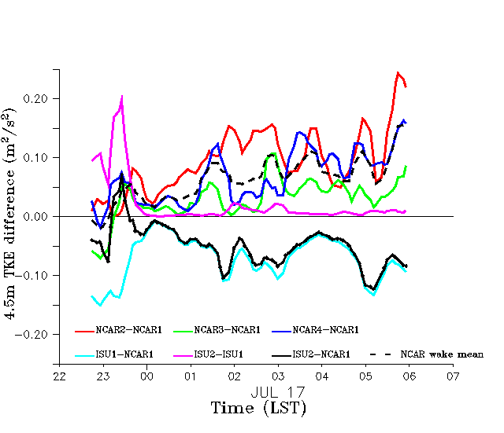
CASE STUDY:
Night 16 Jul 2230-17 Jul 0600
TKE is most enhanced at NCAR2 because of the
faster speeds.
NCAR4: detection of
turbulence from the wake?
Nice null-effect of TKE between the two ISU towers
NCAR 1 ahead of the rotor
has higher turbulence than at
ISU 1 in the gap region

Slide 44
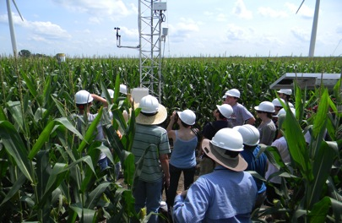
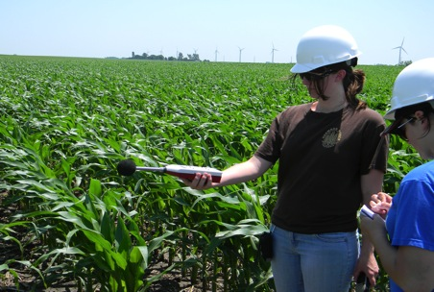
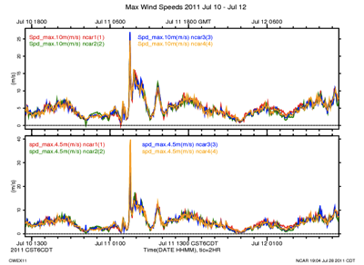
CWEX11
REU student short course in field measurements
NCAR station records 40 m/s (89 mph)wind on 11 July
REU students measure noise levels in the wind farm

Slide 45
A Vision for CWEX13
4H
3H
2H
H
Story II wind turbines

Slide 46
Porté-Agel, Lu, and Wu, 2010
Wuβow, Sitzki, & Hahn, 2007, CFD simulation using ANSYS FLUENT 6.3 LES

Slide 47
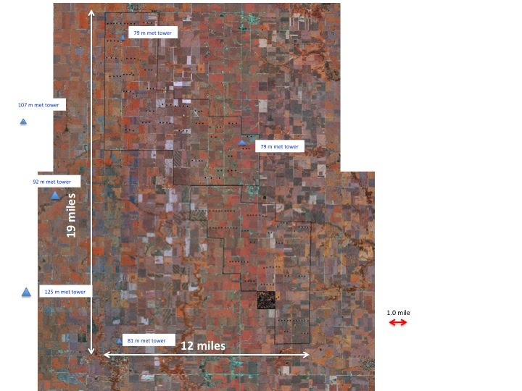

Slide 48
Measurements Needed
Surface fluxes
Horizontal velocity through the turbine layer (H)
Turbulence in the turbine layer with the layer above (H-2H)
Diurnal changes of u, T, RH, turbulence in H-10H
Low-level jet characteristics

Slide 49
Analysis Needed
Surface flux anomalies
Vertical profiles of horizontal velocity through the turbine layer (H)
Coupling of the turbine layer with the layer above (H-2H)
Horizontal convergence in the H layer
Diurnal changes in H-10H
Low-level jet characteristics

Slide 50
Modeling Needed
Diurnal changes of surface fluxes
Coupling of the turbine layer with the layer above (H-2H)
Horizontal convergence in the H layer
Diurnal changes in H-10H
Low-level jet characteristics
Turbine-turbine interactions

Slide 51
Desired Outcomes
Better forecasting capacity for wind farm wind speed
  Understanding/forecasting of ramp events
  Better understanding of LLJs
Range/limits of possible influences on crops
High-resolution modeling of turbine-turbine interactions
High-resolution modeling of turbine-ABL interactions
CWEX becomes the internationally leading wind farm test bed for validating wind farm simulation models

Slide 52
Current Status
Two seasons of successful instrument deployment
NSF Research Experiences for Undergraduates (REU) site program (2011-2013) for Wind Energy Science, Engineering and Policy (WESEP)
NSF Integrated Graduate Education, Research, and Training (IGERT) in WESEP (2012-2017)
Undergraduate minor in WESEP
EPSCoR funding for tower and instrumentation

Slide 53
Current Status
Verbal commitment for NCAR educational deployment of surface instruments for CWEX12
ISU flux stations to be deployed
Indiana University verbal interest
University of Colorado interested in returning for CWEX12 with lidars
Ongoing discussions with DOE about funding CWEX12 and follow-on experiments (strong interest in funding university partners)
Verbal interest from NCAR EOL in a major field campaign (including aircraft) for CWEX13

Slide 54
Current Status
IAWIND funds for instrumentation (discussions under way)
University of Nebraska surface instrumentation commitment
Matching funds from Agronomy Department
Faculty position in the College of Agriculture and Life Sciences on high-resolution wind farm modeling
NLAE will be deploying instruments nearby-but-outside StoryI&II in 2012-2015 in south fork Iowa River (SFIR)
ARS plans major field campaign (air-craft, surface, satellite special obs) in 2015
NASA plans major field campaign for satellite soil moisture obs in SFIR in 2015

Slide 55
Summary
CWEX10/11 have demonstrated the feasibility of a major wind farm observing capability in Central Iowa.
Educational component in place
Strong interest from DOE and NCAR/EOL for expanding current wind farm measurement capabilities toward a wind farm model test bed
Strong interest for university collaborations

Slide 56
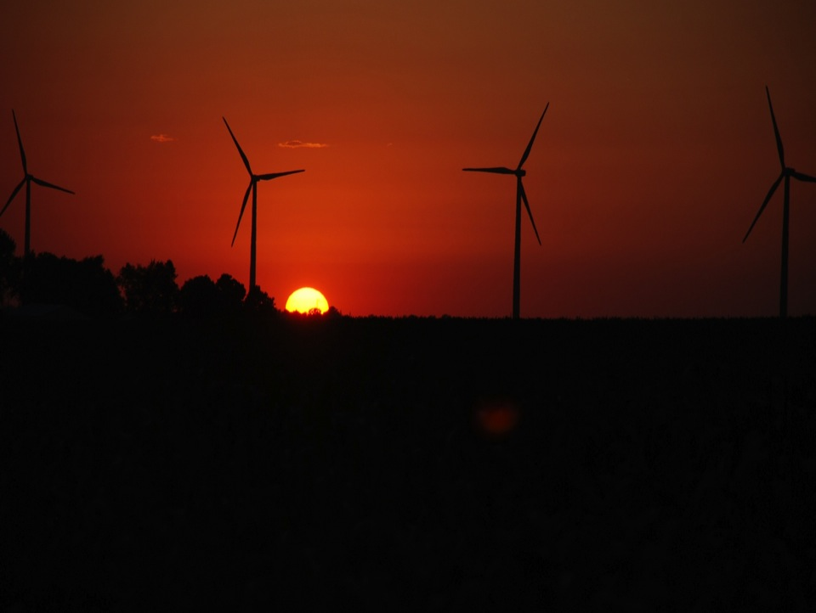
ACKNOWLEDGMENTS
Julie Lundquist for slides from presentation at LANL
Dr. Ron Huhn, property owner
Gene and Todd Flynn, farm operators
Lisa Brasche for photos
Equipment and personnel supplied by the National Laboratory for Agriculture and
the Environment
Funding supplied by
Center for Global and Regional Environmental Research, University of Iowa
MidAmerican Energy Company
Ames Laboratory , Department of Energy
National Science Foundation
Photo courtesy of Lisa H Brasche

Slide 57
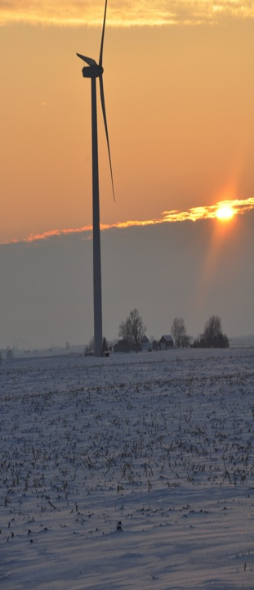
For More Information
Eugene S. Takle
gstakle@iastate.edu
http://www.meteor.iastate.edu/faculty/takle/
515-294-9871
Julie K. Lundquist
Julie.Lundquist@colorado.edu
Julie.Lundquist@nrel.gov
http://atoc.colorado.edu/~jlundqui
303/492-8932 (@CU)
303/384-7046 (@NWTC)
Photo courtesy of Lisa H Brasche

